Slide 1

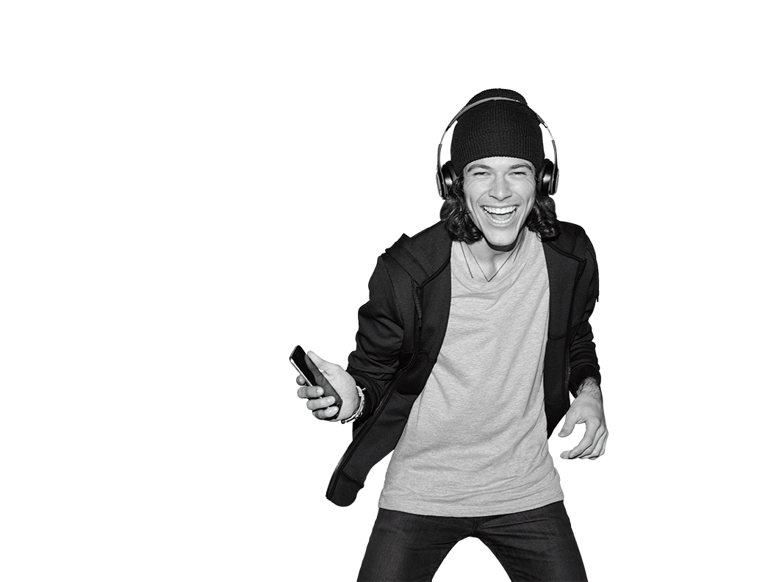


TR# 2017325

Slide 2
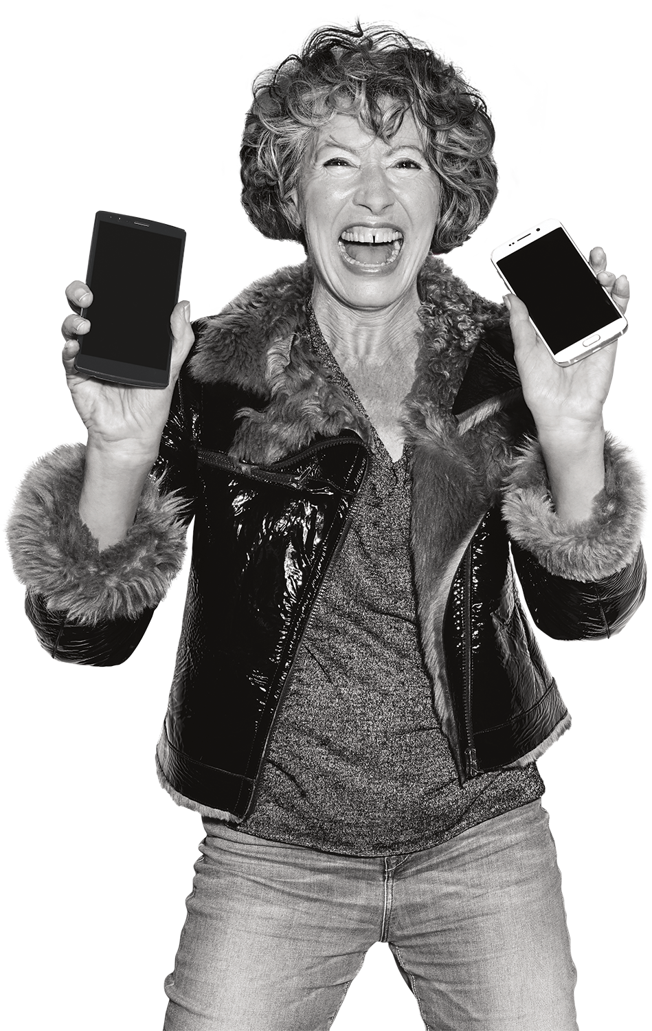

Un-carrier Experience
Commitment
2 – Un-carrier Experience Commitment
T-Mobile confidential and proprietary information. Not for customer distribution.

Slide 3

BRING IT TOGETHER
25 MIN
Create your I Will… statement.
Share it with your class.
Share it with your store manager the first day of Week Three.
Ask for their help in making your I Will… commitment happen.
3 – Un-carrier Experience Commitment
T-Mobile confidential and proprietary information. Not for customer distribution.

